Slide 1
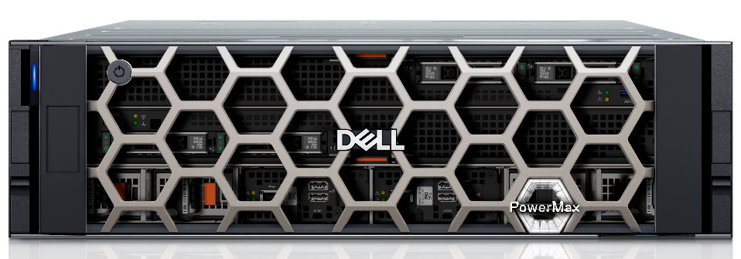
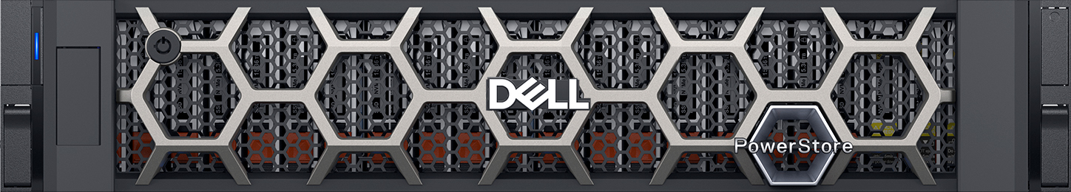
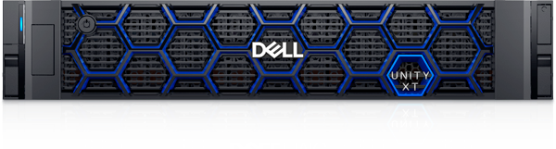
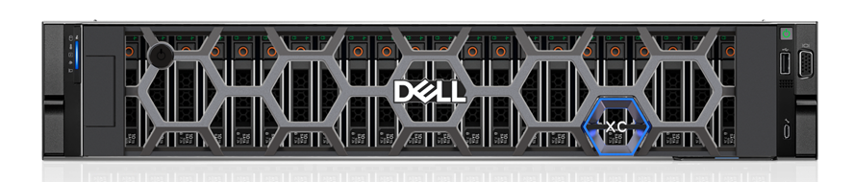
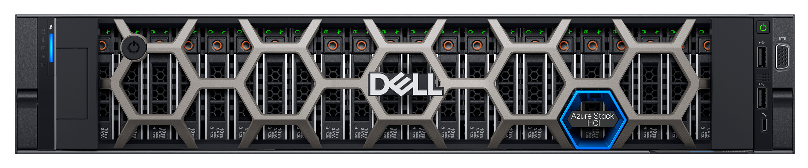
Cloud Inside Specialists Value Add
Custom Demos
Tech & Roadmap Updates
Technical Deep Dives
Customer/Partner
Enablement
Primary Storage
Workload/App Analysis
Internal Enablement Sessions
Multi-cloud
Solutioning & Peer Reviews
Proof Of Concepts
Competitive Landscape
Consultative Conversations
Notes:
Portfolio Coverage: Primary Storage :1. PowerMax 2.PowerStore 3.Unity
Multi-Cloud: 1.VxRails 2.PowerFlex 3.Nutanix XC 4.Azure Local (previously called Azure Stack HCI) 5.Dell Automated Platform Offerings summary:
1.Custom Demos – Tailored demonstrations aligned to specific customer needs and use cases.
2. Technical Deep Dives – Detailed technical explorations of Dell solutions and architectures.
3. Workload/App Analysis – Assessments of workloads and applications to optimize infrastructure fit.
4. Solutioning & Peer Reviews – Collaborative solution design with expert validation and feedback.
5. Competitive Landscape – Insights and positioning strategies against competitor offerings.
6. Tech & Roadmap Updates – Latest technology advancements and product roadmaps shared with stakeholders.
7. Customer/Partner Enablement – Training and guidance to empower customers and partners on Dell solutions.
8. Internal Enablement Sessions – Knowledge-sharing sessions to upskill internal teams.
9. Proof Of Concepts – Real-world validations of solutions in customer environments.
10. Consultative Conversations – Strategic discussions to align technology with business outcomes.

